Slide 1
Software Development Life Cycle (SDLC)
Ankur Jain

Slide 2
Overview
SDLC Model
Waterfall Model
V-Shaped Model
Prototyping
Rapid Application Development
Spiral Model
Conclusion

Slide 3
SDLC Model
A framework that describes the activities performed at each stage of a software development project.

Slide 4
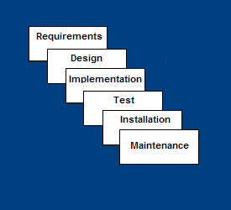
Waterfall Model
Requirements – defines needed information, function, behavior, performance and interfaces.
Design – data structures, software architecture, interface representations, algorithmic details.
Implementation – source code, database, user documentation, testing.

Slide 5
Waterfall Model
Test – check if all code modules work together and if the system as a whole behaves as per the specifications.
Installation – deployment of system, user-training.
Maintenance – bug fixes, added functionality (an on-going process).

Slide 6
Waterfall Strengths
Easy to understand, easy to use
Provides structure to inexperienced staff
Milestones are well understood
Sets requirements stability
Good for management control (plan, staff, track)

Slide 7
Waterfall Deficiencies
All requirements must be known upfront
Deliverables created for each phase are considered frozen – inhibits flexibility
Does not reflect problem-solving nature of software development – iterations of phases
Integration is one big bang at the end
Little opportunity for customer to preview the system (until it may be too late)

Slide 8
When to use the Waterfall Model
Requirements are very well known
When it is possible to produce a stable design
E.g. a new version of an existing product
E.g. porting an existing product to a new platform.

Slide 9
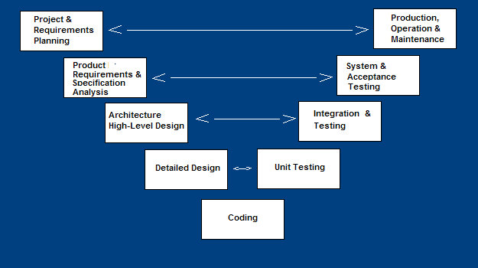
V-Shaped SDLC Model
A variant of the Waterfall that emphasizes the verification and validation of the product.
Testing of the product is planned in parallel with a corresponding phase of development

Slide 10
V-Shaped Steps
Project and Requirements Planning – allocate resources
Product Requirements and Specification Analysis – complete specification of the software system
Architecture or High-Level Design – defines how software functions fulfill the design
Detailed Design – develop algorithms for each architectural component
Coding – transform algorithms into software
Unit testing – check that each module acts as expected
Integration and Testing – check that modules interconnect correctly
System and acceptance testing – check the entire software system in its environment
Production, operation and maintenance – provide for enhancement and corrections

Slide 11
V-Shaped Strengths
Emphasize planning for verification and validation of the product in early stages of product development
Each deliverable must be testable
Project management can track progress by milestones
Easy to use

Slide 12
V-Shaped Weaknesses
Does not easily handle concurrent events
Does not handle iterations or phases
Does not easily handle dynamic changes in requirements

Slide 13
When to use the V-Shaped Model
Excellent choice for systems requiring high reliability – hospital patient control applications
All requirements are known up-front
When design is stable
Solution and technology are known

Slide 14
Prototyping Model
Developers build a prototype during the requirements phase
Prototype is evaluated by end users
Users give corrective feedback
Developers further refine the prototype
When the user is satisfied, the prototype code is brought up to the standards needed for a final product.

Slide 15
Prototyping Steps
A preliminary project plan is developed
An partial high-level paper model is created
The model is source for a partial requirements specification
A prototype is built with basic and critical functions
The designer builds
the database
user interface
algorithmic functions
The designer demonstrates the prototype, the user evaluates for problems and suggests improvements.
This loop continues until the user is satisfied

Slide 16
Prototyping Strengths
Customers can “see” the system requirements as they are being gathered
Developers learn from customers
A more accurate end product
Unexpected requirements accommodated
Allows for flexible design and development
Steady, visible signs of progress produced
Interaction with the prototype stimulates awareness of additional needed functionality

Slide 17
Prototyping Weaknesses
Tendency to abandon structured program development for “code-and-fix” development
Bad reputation for “quick-and-dirty” methods
Overall maintainability may be overlooked
Process may continue forever (scope creep)

Slide 18
When to use Prototyping
Requirements are unstable or have to be clarified
As the requirements clarification stage of a waterfall model
Develop user interfaces
New, original development

Slide 19
Rapid Application Development Model (RAD)
Requirements planning phase (a workshop utilizing structured discussion of business problems)
User design phase – users to participate in the nontechnical design of the system
Construction phase – productivity tools, such as code generators, screen generators.
Cutover phase -- installation of the system, user acceptance testing and user training

Slide 20
Rapid Application Development Model (RAD)
Requirements planning phase
User design phase
Prototyping
Construction phase
Cutover phase

Slide 21
RAD Strengths
Reduced cycle time and improved productivity with fewer people means lower costs
Customer involved throughout the complete cycle minimizes risk of not achieving customer satisfaction and business needs
Focus moves from documentation to code
Uses modeling concepts to capture information about business, data, and processes.

Slide 22
RAD Weaknesses
Accelerated development process must give quick responses to the user
Risk of never achieving closure
Hard to use with legacy systems
Requires a system that can be modularized
Developers and customers must be committed to rapid-fire activities in an abbreviated time frame.
May compromises functionality and performance in exchange for faster development and better application maintenance

Slide 23
When to use RAD
When requirements are not fully understood.
User involved throughout the life cycle
Functionality delivered in increments
High performance not required
System can be modularized

Slide 24
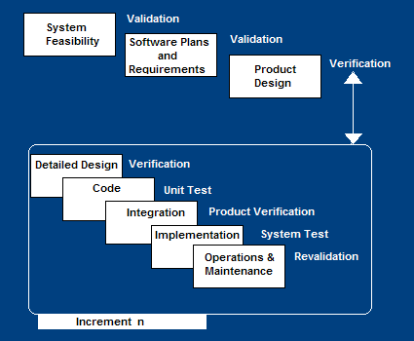
Incremental SDLC Model
Construct a partial implementation of a total system
Then slowly add increased functionality
The incremental model prioritizes requirements of the system and then implements them in groups.
Each subsequent release of the system adds functions to the previous release, until all designed functionality has been implemented.

Slide 25
Incremental Model Strengths
Develop high-risk or major functions first
Each release delivers an operational product
Customer can respond to each build
Uses “divide and conquer” breakdown of tasks
Lowers initial delivery cost
Initial product delivery is faster
Customers get important functionality early

Slide 26
Incremental Model Weaknesses
Requires good planning and design
Requires early definition of a complete and fully functional system to allow for the definition of increments
Well-defined module interfaces are required (some will be developed long before others)
Total cost of the complete system is not lower

Slide 27
When to use the Incremental Model
Most of the requirements are known up-front but are expected to evolve over time
A need to get basic functionality to the market early
On projects which have lengthy development schedules

Slide 28
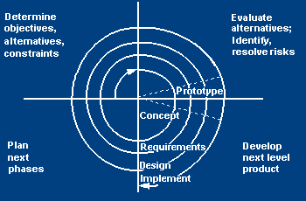
Spiral SDLC Model
Adds risk analysis, and 4gl RAD prototyping to the waterfall model
Each cycle involves the same sequence of steps as the waterfall process model

Slide 29
Spiral Quadrant Determine objectives, alternatives and constraints
Objectives: functionality, performance, hardware/software interface, critical success factors, etc.
Alternatives: build, reuse, buy, sub-contract, etc.
Constraints: cost, schedule, man-power, experience etc.

Slide 30
Spiral Quadrant Evaluate alternatives, identify and resolve risks
Study alternatives relative to objectives and constraints
Identify risks (lack of experience, new technology, tight schedules, etc.)
Resolve risks

Slide 31
Spiral Quadrant Develop next-level product
Typical activites:
Create a design
Review design
Develop code
Inspect code
Test product

Slide 32
Spiral Quadrant Plan next phase
Typical activities
Develop project plan
Develop a test plan
Develop an installation plan

Slide 33
Spiral Model Strengths
Provides early indication of insurmountable risks, without much cost
Users see the system early because of rapid prototyping tools
Critical high-risk functions are developed first
Users can be closely tied to all lifecycle steps
Early and frequent feedback from users

Slide 34
Spiral Model Weaknesses
Time spent for evaluating risks too large for small or low-risk projects
Time spent planning, resetting objectives, doing risk analysis and prototyping may be excessive
The model is complex
Risk assessment expertise is required
Spiral may continue indefinitely
Developers must be reassigned during non-development phase activities

Slide 35
When to use Spiral Model
When creation of a prototype is appropriate
When costs and risk evaluation is important
For medium to high-risk projects
Users are unsure of their needs
Requirements are complex
New product line
Significant changes are expected

Slide 36
Tailored SDLC Models
No single model fits all projects
If there is no suitable model for a particular project, pick a model that comes close and modify it for your needs.
If project should consider risk but complete spiral model is too much – start with spiral and simplify it
If project should be delivered in increments but there are serious reliability issues – combine incremental model with the V-shaped model
Each team must pick or customize a SDLC model to fit its project

Slide 37
Quality – the degree to which the software satisfies stated and implied requirements
Absence of system crashes
Correspondence between the software and the users’ expectations
Adherence to specified requirements
Quality must be controlled because it lowers production speed, increases maintenance costs and can adversely affect business
the good enough is enemy of the excellent

Slide 38
Quality Assurance Plan
The plan for quality assurance activities should be in writing so all stakeholders can review it during the lifecycle.
Some elements that should be considered by the plan are: defect tracking, unit testing, source-code tracking, integration testing and system testing.

Slide 39
Quality Assurance Plan
Defect tracing – keeps track of each defect found, its source, when it was detected, when it was resolved, how it was resolved, etc
Unit testing – each individual module is tested
Source code tracing – step through source code line by line
Integration testing - test new code in combination with code that already has been integrated
System testing – execution of the software for the purpose of finding defects.

Slide 40
Conclusion
SDLC
A framework that describes the activities performed at each stage of a software development project.
Waterfall and V-Shaped and Incremental models need requirements to be known up-front.
E.g. when creating new versions of existing systems.
Prototyping, RAD and Spiral models do not need all requirements to be known
E.g. New systems.
Uses series of prototypes that evolve into the finished system.

